Slide 1
CISSP Operations Security Domain
Presented by
Adam Ossenford

Slide 2
Agenda
Introduction
Study & Preparation Tips
Exam Taking Tips
That is new to me
Operations Security Domain
Practice Questions & more Practice Questions
Super Awesome Stuff!!!! JUST FOR YOU!

Slide 3
About Me
Adam Ossenford
AdamOssenford@gmail.com
https://www.linkedin.com/in/AdamOssenford
KC ISSA member since 2010
http://seckc.org/founding-members/
Hold various certifications such as CISSP, CEHv7, Security+, Linux+, CCNA-S, ACMP, etc
Sat for the CISSP exam in Kansas City on July 23, 2011
Received the news that I had passed the exam on August 15, 2011
Completed and had my endorsement forms mailed in on August 25, 2011
(ISC)2 notified me that they had received my endorsement forms on August 26, 2011
Was informed that I was officially a CISSP on October 4th, 2011
My current CISSP status is Active. CISSP # 398693

Slide 4
STANDARD DISCLAIMER
I am here to try to help you pass the CISSP exam
I do not have all the answers
I do not claim to know all the answers
I will do everything I can to share my knowledge
I encourage group discussion
PowerPoint is definitely not my strong suit

Slide 5
Study & Preparation Tips
Register for the exam online http://www.pearsonvue.com/isc2/
Set your exam date and work backwards to create your study plan.
Sign up for the forums on http://www.cccure.org/forums.html Specifically the CISSP forums are extremely useful http://www.cccure.org/modules.php?name=Forums&file=index&c=2
Read about the Common Criteria http://www.commoncriteriaportal.org/pps/
Read some NIST documents http://csrc.nist.gov/publications/PubsSPs.html
Sign up for the cccure quiz engine https://www.freepracticetests.org/quiz/index.php?page=quiz
I purchased the paid version during my test preparation and went through approximately 2500 questions prior to sitting for the exam

Slide 6
Study & Preparation Tips
Do not be afraid to use multiple resources for your study plan. I used a few different books along with mp3 audio lectures, papers, websites, etc, etc
Take a look at http://avitria.com/cisspstudyplan.html
Read over the CISSP aide memoir http://www.cccure.org/modules.php?name=News&file=article&sid=1103
Check LinkedIn for CISSP study groups
Use index cards to make your own flash cards. This technique was very helpful for memorizing terminology prior to the exam
If you come across additional resources “collect and trade” with your fellow study group members
Attend some of the KC ISSA meetings. They are a great resource for knowledge on various topics along with providing a place to network with other CISSP’s. Check out the website http://kc.issa.org for the schedule of upcoming events

Slide 7
Exam Preparation
The following are tips and exam taking strategy pointers that I collected from various other CISSP’s who had been there and done that along with a few of my own
Arrive early to the test center
Stay in a hotel close to the exam center if you have to
This should keep your pre exam time stress free
BRING YOURSELF A LUNCH/SNACK & BOTTLED DRINK!
I cannot stress this enough, it made a HUGE difference for me
I brought in some deli sliced turkey with cheese and a couple bite sized candy bars in a disposable bag
I also brought in a 1 liter soda that was sealed( passed inspection)
* Check the rules with your test center prior to your exam *

Slide 8
Exam Preparation
The following are tips and exam taking strategy pointers that I collected from various other CISSP’s who had been there and done that along with a few of my own
Game plan your testing strategy
An example of my strategy
I took the first 100 questions then used the restroom. Splashed water on my face, stretched, bent over at the waist and shook out my arms to relieve neck tension
After returning to the exam I finished 50 more questions and stopped after question 150 to have lunch
After lunch I felt refreshed and finished the last 100 questions without an additional restroom break
I would suggest planning out your exam strategy and making your own milestones for breaking points.

Slide 9
Exam Preparation
The following are tips and exam taking strategy pointers that I collected from various other CISSP’s who had been there and done that along with a few of my own
Modify your exam approach accordingly but plan on taking a break to help regain your focus at some point
DO NOT SECOND GUESS YOURSELF. I would suggest going with your initial instinct and do your best to refrain from going back and changing answers once you have completed a question.
Eliminate the answers you know are incorrect
Pick the best possible answer from the responses that are left
It is easy to be intimidated by this test. (I was)
Try not to be intimidated but give it the respect it deserves.
It might not seem like it but it is possible to pass the exam ☺ keep that in mind but realize it will take a lot of hard work and dedication to achieve your ultimate goal of a passing grade

Slide 10




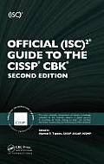
Exam Preparation
Useful Study Materials

Slide 11
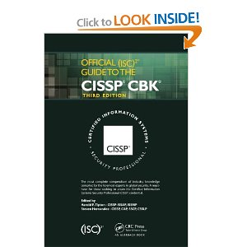

That is new to me
Shon Harris CISSP
All-In-One 6th edition
ISC2 Official guide to
the CISSP CBK 3rd edition

Slide 12
That is new to me
Where is my scantron sheet and #2 pencil ????
Computer Based Testing and Test Centers
Scenario Based Questions
Not just multiple guess anymore
https://www.cccure.org/article1631.html

Slide 13

Operations Security Domain

Slide 14
ISC2 CISSP candidate information bulletin
https://www.isc2.org/candidate-information-bulletin.aspx
Overview
Security Operations domain is used to identify critical information and the execution of selected measures that eliminate or reduce adversary exploitation of critical information. It includes the definition of the controls over hardware, media, and the operators with access privileges to any of these resources. Auditing and monitoring are the mechanisms, tools and facilities that permit the identification of security events and subsequent actions to identify the key elements and report the pertinent information to the appropriate individual, group, or process.
The candidate is expected to know the resources that must be protected, the privileges that must be restricted, the control mechanisms available, the potential for abuse of access, the appropriate controls, and the principles of good practice.

Slide 15
ISC2 CISSP candidate information bulletin
https://www.isc2.org/candidate-information-bulletin.aspx
Key Areas of Knowledge
A. Understand security operations concepts
A.1 Need-to-know/least privilege
A.2 Separation of duties and responsibilities
A.3 Monitor special privileges (e.g., operators, administrators)
A.4 Job rotation
A.5 Marking, handling, storing and destroying of sensitive information
A.6 Record retention

Slide 16
ISC2 CISSP candidate information bulletin
https://www.isc2.org/candidate-information-bulletin.aspx
Key Areas of Knowledge (cont.)
B. Employ resource protection
B.1 Media management
B.2 Asset management (e.g., equipment life cycle, software licensing)
C. Manage incident response
C.1 Detection
C.2 Response
C.3 Reporting
C.4 Recovery
C.5 Remediation and review (e.g., root cause analysis)

Slide 17
ISC2 CISSP candidate information bulletin
https://www.isc2.org/candidate-information-bulletin.aspx
Key Areas of Knowledge (cont.)
D. Implement preventative measures against attacks
(e.g., malicious code, zero-day exploit, denial of service)
E. Implement and support patch and vulnerability management
Understand change and configuration management
(e.g., versioning, base lining)
G. Understand system resilience and fault tolerance requirements
Certified Information Systems Security Professional CISSP®
Candidate Information Bulletin
Effective Date 1 January 2012

Slide 18
Security Operations
Administrative management responsibilities
Operations department responsibilities
Configuration management
Trusted recovery states
E-mail security
Threats to operations security

Slide 19
Operations Security
Everything that takes place to keep networks, computer systems, applications, and environments up and running in a secure and protected manner.
Operations take place after the network is developed and implemented.
This includes the continual maintenance of an environment and the activities that should take place on day-to-day or week-to-week basis

Slide 20
Role of the Operations Dept
The continual effort to make sure the correct policies procedures, standards and guidelines are in place and being followed.
Due Diligence – going through the necessary steps to know what a company’s or individuals actual risks are
Due Care – carrying out responsible actions to reduce those risks
Configuration, performance, fault tolerance, security, accounting and verification management

Slide 21
Administrative Management
Separation of duties – the concept of having more than one person required to complete a task
Job rotation – a control used to detect errors and fraud by employees. It also helps business continuity as multiple people are equally equipped to perform a job function
Least privilege – ensuring an individual has just enough privileges and rights to fulfill their role with the company and nothing more.
Mandatory Vacations – requiring vacation time which can help a company uncover fraudulent activities being performed by an individual

Slide 22
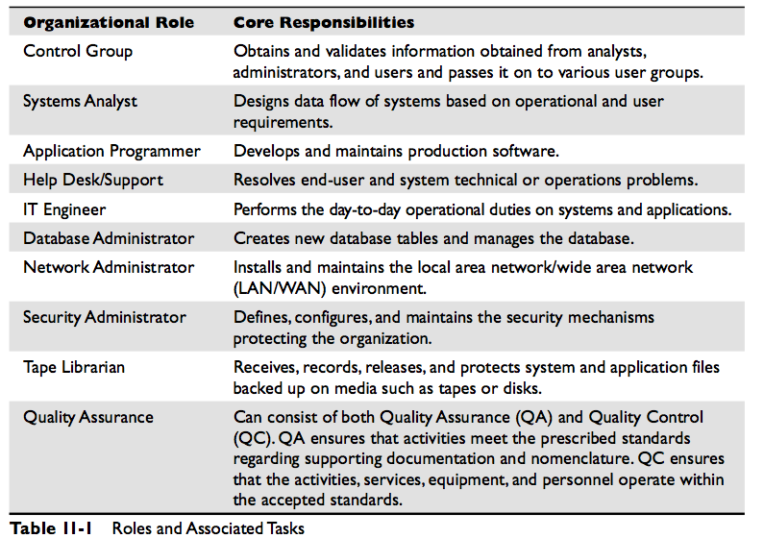

Slide 23
Security and Network Personnel
Duties of the Security administrator
Implements and maintains security devices and software
Carries out security assessments
Creates and maintains user profiles
Implements and maintains access control mechanisms
Configures and maintains security labels in mandatory access control (MAC) environments
Set initial passwords for users
Review audit logs
Security administrator should not report to the network administrator

Slide 24
Accountability
Monitoring users access to resources to ensure that privileges are properly controlled.
Are users accessing information that is not necessary for their job description?
Are people making repetitive mistakes
Do too many users have access to restricted data or resources?

Slide 25
Managing Security Technologies
Boundary Controls – used to create division between more trusted and less trusted environments. Could be network based such as firewalls, routers, or proxies. Could be deployed on individual systems through kernel functions, anti-malware systems, and ring protection
Monitoring and Reporting services – Reviewing log files gives you a view into security related events. System audit logs collect valuable information about the system but might not alert security professionals.
Clipping Level – The number of certain errors that will be allowed before the activity is considered to be suspicious. The threshold is a baseline for violation activities that may be normal for a user to commit before alarms are raised on the system

Slide 26
Managing Security Technologies
Security Event Management (SEM) – solutions intended to provide a common platform for log collection, collation, and analysis in real-time for more effective and efficient response. Also known as…
SIEM (Security Information and Event Management) or
SIM (Security Information Management)
Log Management Systems – They also collect logs and provide the ability to report against them but they are more focused on historical analysis of log information.

Slide 27
Intrusion Detection Systems (IDS) – Provide real time or near real time monitoring and alerting after determining an attack is currently underway
HIDS – Host Intrusion Detection Systems – Can only monitor and alert about events on the host that it is currently installed on.
NIDS – Network Intrusion Detection Systems – Monitors and alerts about events taking place on the network segment which it is installed on
Intrusion Prevention Systems (IPS) – Provide real time or near real time monitoring and have the ability to attempt to block or prevent an attack after determining one is currently underway.
HIPS – Host Intrusion Prevention Systems – Can only monitor and attempt to prevent attacks on the host it is installed on.
NIPS – Network Intrusion Prevention Systems – Monitors and attempts to prevent attacks when they are detected on the network

Slide 28
Deployment of IDS or IPS
Out of Band – deploying a solution that is not in the middle of the communications path. This will not affect normal processing or cause latency but some attacks might reach their intended target
In Line / In Band – deployed in the direct line of the communications path. Typically cause some latency and can cause a slow down of processing to some extent. Attacks however will not likely reach their intended targets
Signature Based / Pattern Matching / Knowledge Based Systems – attempt to detect attacks based on a long list of previously known attack patterns.
Protocol Anomaly Systems- attempt to detect attacks by determining if the protocol deviates from it’s defined standards

Slide 29
Statistical Anomaly / Behavioral Based detection systems
Establish a baseline for normal traffic patterns and then alert once they detect any deviations from the baseline.
Can detect previously unknown attacks
Can generate large amounts of false positives
Can use heuristics on behavior of network traffic in an attempt to determine if it was malicious or not

Slide 30
False Positives – Alerting on something that is no big deal
( crying wolf )
False Negatives – Very dangerous. Missing legitimate attacks
Vulnerability Management Systems – scanning your own network for vulnerabilities in order to detect and mitigate potential problems. Can use scanning tools and techniques which are host or network based.
Anti Malware Systems – used to scan for, detect, and prevent the presence of malware on the network and/or systems.

Slide 31
Operational Assurance – continually maintaining a necessary level of protection.
Life-Cycle Assurance – Maintaining an assurance level throughout a products entire life cycle.
Design specifications
Clipping level configurations
Unit testing
Configuration management
Trusted distribution
Asset Management – Knowing what the company currently owns in inventory

Slide 32
Maintaining Resilient Systems
Initial Program Loads – a mainframe term for loading the kernel into memory
Trusted Paths – trustworthy interfaces into privileged user functions that ensure any communications over that path cannot be intercepted or corrupted
Trusted Recovery – Maintaining a secure state in the event of an operating system or application crash.
System reboot – system shuts itself down in a controlled manner in response to a failure in the trusted computing base
Emergency system restart – takes place after a system failure happens in an uncontrolled manner and the system needs to restart to recover

Slide 33
Maintaining Resilient Systems
System cold start – takes place when an unexpected kernel or media failure happens and the regular recovery procedure cannot recover to a more consistent system state
After a crash
Enter into single user or safe mode
Fix issue and recover
Validate critical files
Validate system operations

Slide 34
Maintaining Resilient Systems
Fail-Safe – failing in a way that focuses on maintaining minimal harm to personnel
Fail-Secure - failing in a controlled manner to block access while the systems are in an inconsistent state.
Example
A fail-safe door on a data center would ensure that all personnel can escape the area when the power fails.
A fail-secure door would prevent anyone from using the door which could put personnel in harms way

Slide 35
Security Concerns
Bootup Sequence should not be available to reconfigure on the system
Bios password
Writing actions to system logs should not be able to be bypassed
System forced shutdown should not be allowed
Output should not be able to be rerouted
Online transactions must be recorded and time stamped
Data entered should be correctly formatted and validated

Slide 36
Change Control Process
Request for a change to take place
Approval of the change
Documentation of the change
Test and present the change
Implement the change
Report the change to management

Slide 37
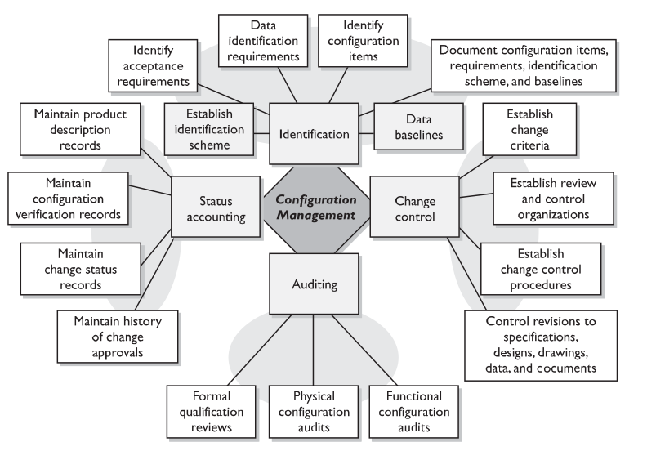

Slide 38
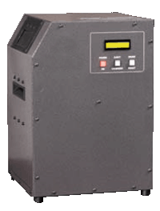
Managing Security Technologies
Media Management- To store media appropriately preserving information and to prevent data leakage, data remanence, and object reuse.
Degausers – Specialized hardware devices which can be used to erase magnetic media through coercivity.
Coercivity – The measure of the amount of energy needed to reduce the magnetic field to zero.
Zeroization- Writing zeros over information repeatedly until it is destroyed and considered sanitized
Shredding/Destruction – Physically destroying the media

Slide 39
Media Management
Tracking the chain of custody
Effectively implement access controls
Track backup versions
Document the media change history
Ensure environmental conditions do not endanger media
Ensure media integrity
Run inventory on a scheduled basis
Carry out secure disposal activities
Internal and external labeling of media

Slide 40
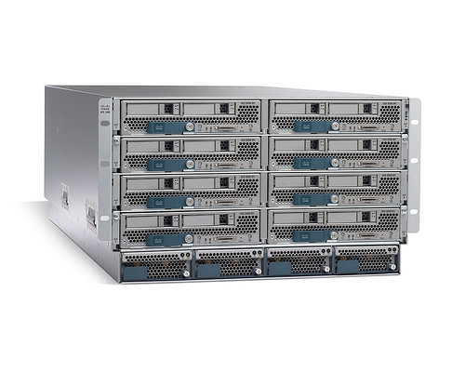
Maintaining Resilient Systems
Redundant systems – Having more than 1 system dedicated to providing services. If one becomes unavailable another server can take over.

Slide 41
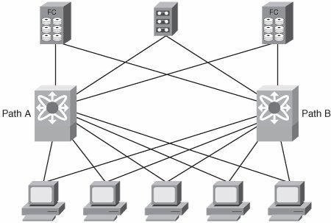
Maintaining Resilient Systems
Redundant networks – Similar to redundant systems but instead provide redundant network connectivity

Slide 42

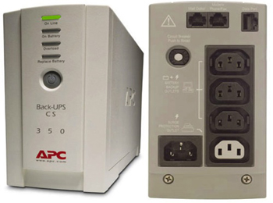
Maintaining Resilient Systems
Redundant power supplies – dual power supplies
UPS – uninterruptible power supplies. Provide power in the event of an outage. Commonly paired with alternate power sources such as diesel-based or natural gas based generators

Slide 43
Maintaining Resilient Systems
MTBF – (Mean Time Between Failures) – the estimated lifespan of a piece of equipment. Typically calculated by the vendor or a 3rd party
MTTF – (Mean Time To Failure) – estimate of the average or mean time until a design or components first failure
MTTR – (Mean Time To Repair) – the amount of time it is expected to take to get a device fixed and back into production
http://en.wikipedia.org/wiki/Mean_time_between_failures

Slide 44
Think about the following….
Say you are given the task of obtaining hardware for a project that will last 3 years.
For performance purposes you select solid state drives for the database server.
The database server will perform around 100,000 writes to disk each month
For disaster recovery purposes you setup the database with a raid 1 mirrored pair of solid state drives which have a MTTF of 3 million write transactions
Do you see the problem here?
(100,000 writes per month) * ( 36 months )
= 3,600,000 write transactions in a 3 year period.
Your disks fail around 3 million write transactions on average.
You will be operating a disk which on average will fail 6 months short of your goal

Slide 45
Maintaining Resilient Systems
SSD – Solid State Disks
SAN – Storage Area Network
NAS – Network Attached Storage
JBOD – Just a Bunch of Disks ( no redundancy )
Tape Vaulting – Making multiple copies of tapes to use for backup and recovery
Database Shadowing – database management technique of updating records in multiple locations.
RAIT – Redundant array of independent tapes
RAID – Redundant array of independent disks
MAID – Massive array of inactive Disks (powersave)
RAIT – Redundant array of independent tapes

Slide 46
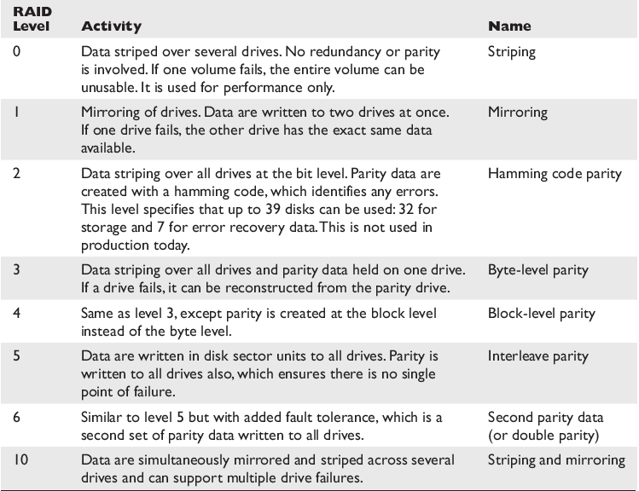
Redundant Array of Inexpensive Disks (RAID)

Slide 47
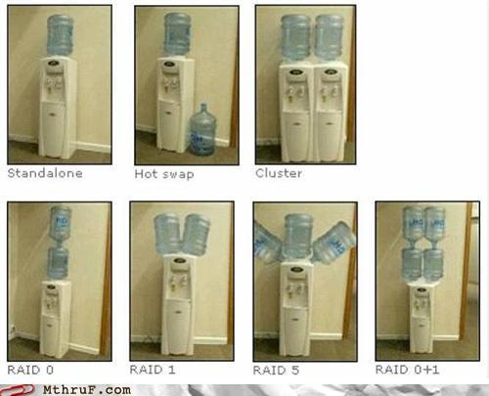
Redundancy humor

Slide 48
Maintaining Resilient Systems
Redundancy and fault tolerance – systems that can continue to operate in the event of a component failure
Cold Spares – A spare component that is not powered up but is a duplicate that can be inserted into the system to replace the primary if needed.
Warm Spares – A spare component normally already inserted but not receiving power until required
Hot Spares – A spare inserted into the system and powered on waiting to be called upon as needed
Grid Computing – Load balanced parallel processing systems running in clusters working together to solve problems on a large scale
Rainbow Tables – pre created databases that contain password hashes that can be used to crack passwords

Slide 49
Maintaining Resilient Systems
Backup Windows – The time used to backup systems. Typically after hours when system usage is at the lowest point
Full Backup – A backup where ALL files are backed up
Differential Backup – A backup where only the files that changed since the last full backup are backed up. Does not reset the archive bit
Incremental Backup – A backup where only files that have changed since the last backup, (full or incremental), are backed up. Resets Archive bit

Slide 50
Maintaining Resilient Systems
Electronic Vaulting – backing up system files across the network to a different geographical location
Electronic Journaling – Database backup technique where transactions are written to alternate systems at an alternate geographical location
Store backup tapes at an offsite facility
Staff for resilience
Cross train employees so that multiple individuals can cover for each other.

Slide 51
Hierarchical Storage Management
Hierarchical Storage Management (HSM)
A data storage technique which automatically moves data between high-cost and low-cost storage media.
HSM systems exist because high-speed storage devices such as hard disk drive arrays and SAN trays are more expensive per byte stored than slower devices.

Slide 52
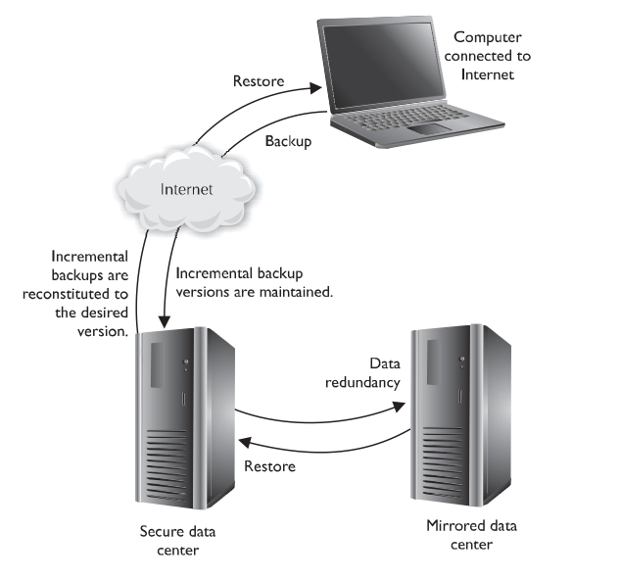
Hierarchical Storage Management
Provides continuous online backup functionality

Slide 53
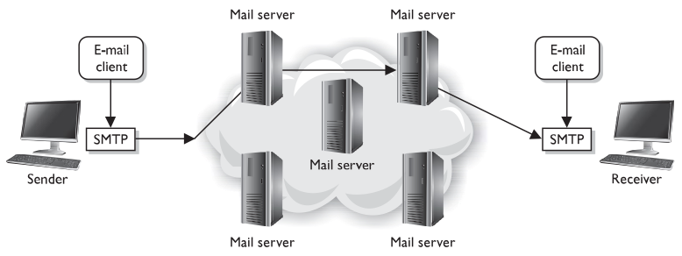
Email Security
Spoofing – altering the name of the from field
Phishing – using email spoofing as a social engineering tactic to get users to click on malicious links
SMTP – simple mail transfer protocol (port 25 typically)

Slide 54
Email Security
POP – post office protocol
( port 110 typically )
Allows users to download messages from a mailbox
IMAP – Internet Message Access Protocol
( port 143 typically )
Provides the same functionality as pop but has more functionality.
Open Relay – allows anyone to relay smtp messages through the system.
If your mail server is setup as an open relay your going to have a bad time

Slide 55
Hax0ring stuff
Browsing – looking through another persons files looking for various info
Network Sniffer – a tool that monitors traffic as it passes through the network.
Aka network analyzers / protocol analyzers
Session Hijacking – spoofing information to take over a users session
Loki – a covert channel tool that uses the ICMP protocol for communications purposes

Slide 56
Hax0ring stuff
Password Cracking – attacking systems or hashes to find password combinations
Backdoors – covert access into systems
DOS attack – Denial of Service attacks are used to overwhelm a system and cause outages
DDOS attack – Using distributed systems to perform a DOS attack
MITM – Man in the middle attack is where the attacker sits in between two computers and intercepts them messages being passed back and forth

Slide 57
Hax0ring stuff
Mail bombing – Overwhelming mail servers and clients with unrequested emails
War dialing – brute forcing the dialing of modems
Used in the movie war games
( do you want to play a game ?
Ping of death – Oversized ICMP packets sent to the victim which freezes the victim machine
Fake login screens – used to scrape legit login information for later use
Teardrop – Sending malformed fragmented packets to a victim which causes a machine to freeze when the packets are reassembled

Slide 58
Hax0ring stuff
Traffic analysis – uncovering information by watching the patterns on a network.
Slamming and cramming – modifying a users service provider without consent resulting in additional charges.
Vulnerability Testing
Evaluate the true security posture
Identify as many vulnerabilities as possible
Personnel testing
Physical testing
System and network testing

Slide 59
Hax0ring stuff
Penetration Testing – simulating actual attacks on systems.
Goes beyond vulnerability testing
Actively attempts to exploit discovered vulnerabilities
Get out of jail free card – a document containing the scope of work for a pentest and can allow a person performing work to not get in trouble
Degrees of knowledge about a pen test target
Zero – pen team has no knowledge
Partial – pen team has some
Full knowledge – team has intimate knowledge of target

Slide 60
Hax0ring stuff
5 steps of a pen test
Discovery – footprinting and gathering info
Enumeration – portscanning and resource identification
Vulnerability mapping – Identifying vulnerable systems
Exploitation – attempting to gain access
Reporting to management – delivering the results of the pen test to management
Blind test – can only use publicly available data and security staff is aware
Double blind test – also blind test to the assessor and security staff is not notified.

Slide 61
Hax0ring stuff
Kernel Flaws – Problems that occur below the level of the user interface deep inside the operating system
Countermeasure – Ensure security patches are up to date
Buffer overflows – overwriting data or program memory after the end of the allocated buffer to perform code execution or unauthorized system access
Countermeasure – use code reviews and enhanced programming libraries. Use DEP (data execution prevention)

Slide 62
Hax0ring stuff
Symbolic links – may allow an attacker to damage data or gain privileged access to systems
Countermeasure – programs and scripts need to use full path to files and binaries
File and directory permissions – make sure you use the practice of least privilege when structuring file and directory permissions.

Slide 63
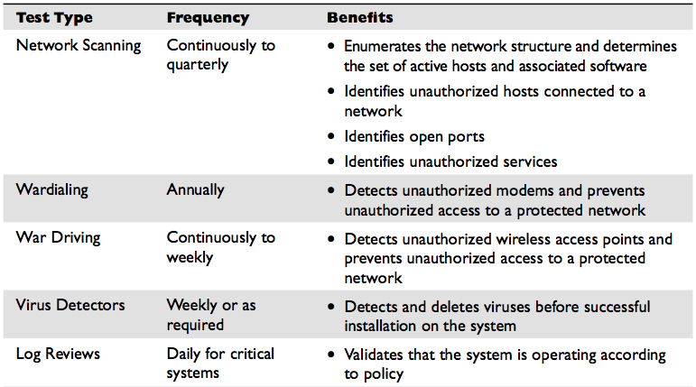
Hax0ring stuff

Slide 64
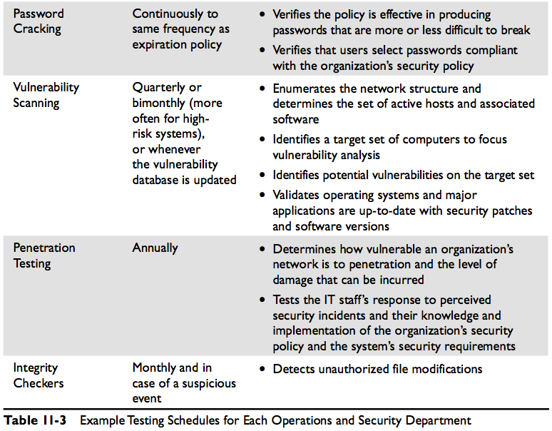

Slide 65
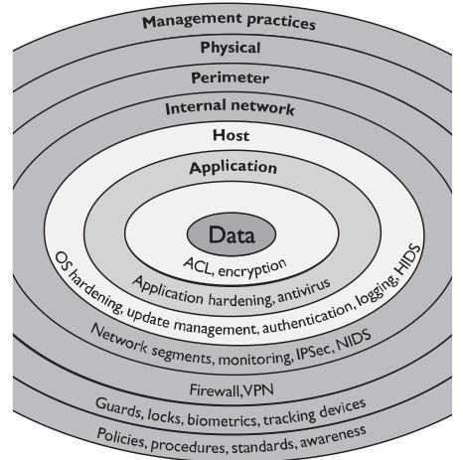

Slide 66
Operations Security Domain

Slide 67

Now we will look at some Example Questions

Slide 68
Questions
Please remember that these questions are formatted and asked in a certain way for a reason.
Keep in mind that the CISSP exam is asking questions at a conceptual level.
Questions may not always have the perfect answer, and the candidate is advised against always looking for the perfect answer.
Instead, the candidate should look for the best answer in the list

Slide 69
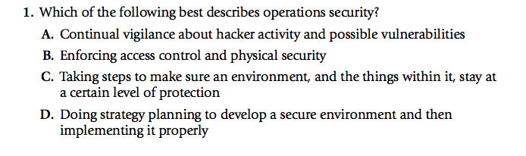
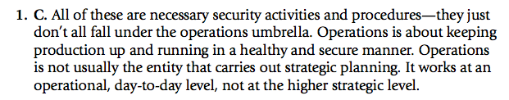
Practice Questions

Slide 70
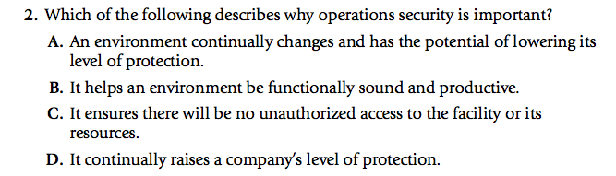
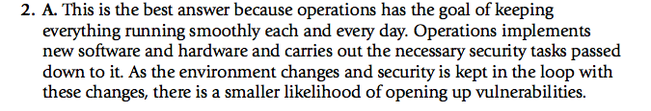
Practice Questions

Slide 71

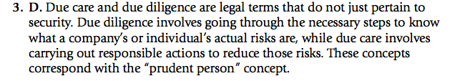
Practice Questions

Slide 72
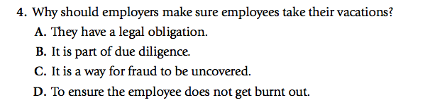
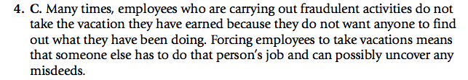
Practice Questions

Slide 73
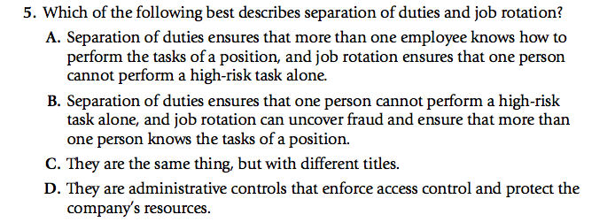
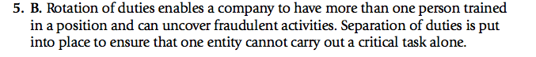
Practice Questions

Slide 74
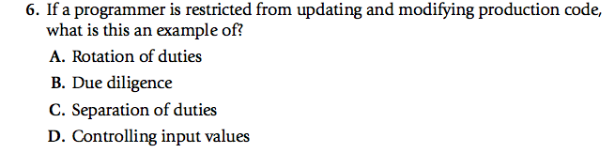
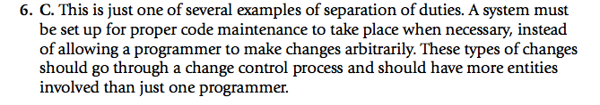
Practice Questions

Slide 75
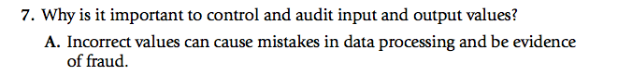
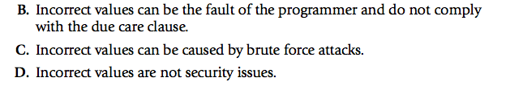
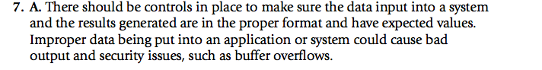
Practice Questions

Slide 76
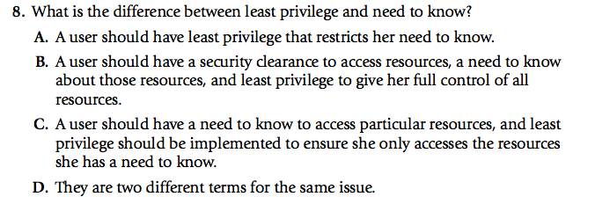
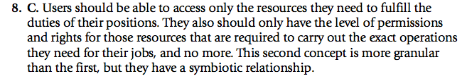
Practice Questions

Slide 77
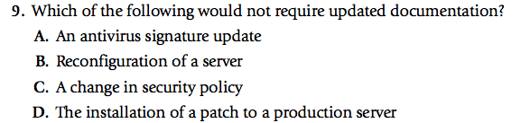
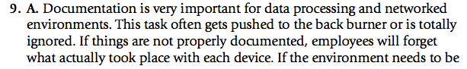
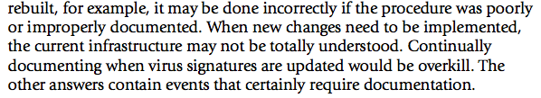
Practice Questions

Slide 78
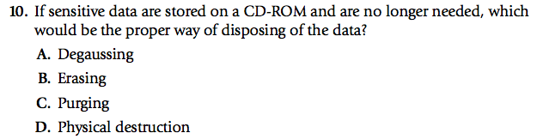
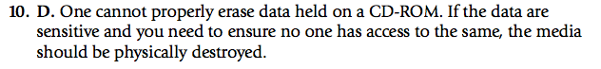
Practice Questions

Slide 79
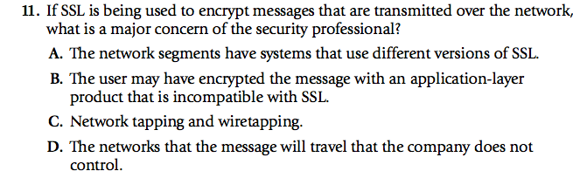
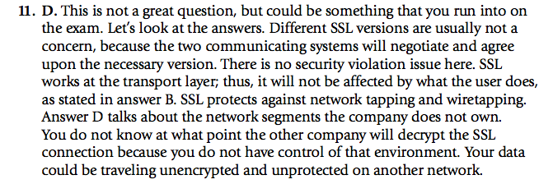
Practice Questions

Slide 80
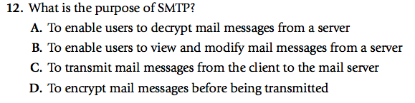
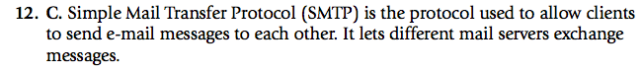
Practice Questions

Slide 81
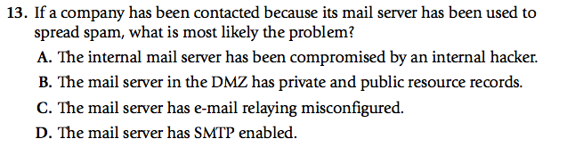
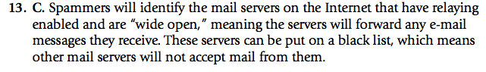
Practice Questions

Slide 82
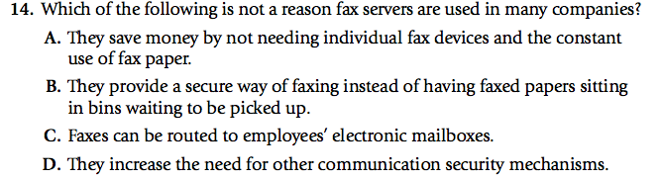
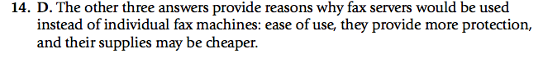
Practice Questions

Slide 83
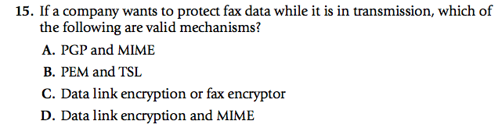
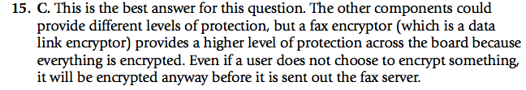
Practice Questions

Slide 84
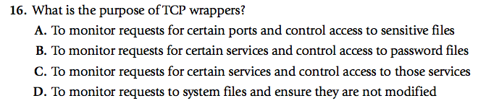
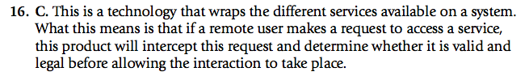
Practice Questions

Slide 85
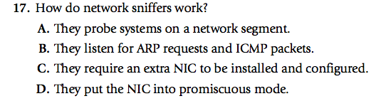
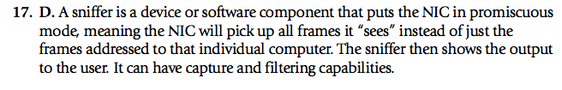
Practice Questions

Slide 86

Practice Questions

Slide 87


Practice Questions

Slide 88


Practice Questions

Slide 89


Practice Questions

Slide 90


Practice Questions

Slide 91

Practice Questions

Slide 92


Practice Questions

Slide 93


Practice Questions

Slide 94


Practice Questions
26. C. Network redundancy is duplicated network equipment that can provide a backup in case of network failures. This technology protects the company from single points of failure

Slide 95
Now we will look at some additional questions
These questions are from the Official CISSP CBK study guide version 2.

Slide 96
Question 1 In the event of a security incident, one of the primary objectives of the operations staff is to ensure that…
A. the attackers are detected and stopped
B. there is minimum disruption to the organization’s activities
C. appropriate documentation about the event is maintained as chain of evidence
D. the affected systems are immediately shut off to limit the impact.
Question 1 Answer
Correct answer is B. While the operations staff may be able to detect the attack and in some cases the attackers, there is very little that the operations staff can do to stop them. All actions taken by the operations staff as they respond to handle the security incident must follow established protocols and be documented, but this is not their primary objective. The affected systems must only be shut off after necessary data or evidence that will be admissible in court is collected. The best answer choice is that the operations staff must maintain operational resilience; i.e., there is minimum disruption to the organization’s activities.

Slide 97
Question 2 For which of the following groups is the threat of unauthorized disclosure of sensitive information most likely to go unnoticed in the absence of auditing?
A. Malicious software (malware)
B. Hacker or cracker
C. Disgruntled employee
D. Auditors
Question 2 Answer
Correct answer is C. Insiders (employees, contractors, etc.) can have access to information that they should not be allowed to and in the absence of auditing (logging) their actions can go unnoticed. Encryption can provide controls over unauthorized disclosure. External attacker (hacker or cracker) activity and malware usually raise alerts on intrusion detection systems (IDS). Auditors may have the need and authorization for the disclosure of sensitive information and this access is often monitored.

Slide 98
Question 3 Which of the following provides controlled and unintercepted interfaces into privileged user functions?
A. Ring protection
B. Anti-malware
C. Maintenance hooks
D. Trusted paths
Question 3 Answer
Correct answer is D. Ring protection can be used to enforce boundary control between kernel functions and end-user controls. Anti-malware software is used to protect against malicious software. Maintenance hooks are coding constructs written by the software developer for troubleshooting and impersonation purposes, but can be a potential backdoor for malicious software. Trusted paths provide trustworthy interfaces into privileged user functions and are intended to provide a way to ensure that any communications over that path cannot be intercepted or corrupted.

Slide 99
Question 4 The doors of a data center opens up in the event of a fire. This is an example of…
A. Fail-safe
B. Fail-secure
C. Fail-open
D. Fail-closed
Question 4 Answer
Correct answer is A. Fail-safe mechanisms focuses on failing with a minimum of harm to personnel while fail-secure focuses on failing in a controlled manner to block access while the systems is in an inconsistent state. For example, data center door systems will fail safe to ensure that personnel can escape the area when the electrical power fails. A fail-secure door would prevent personnel from using the door at all, which could put personnel in jeopardy. Fail-open and fail-closed are fail safe mechanisms.

Slide 100
Question 5 In order to ensure constant redundancy and fault-tolerance, which of the following type of spare is recommended?
A. Cold spare
B. Warm spare
C. Hot spare
D. Archives
Question 5 Answer
Correct answer is C. A cold spare is a spare component that is not powered up but is a duplicate of the primary component that can be inserted into the system if needed. Warm spares are those that are already inserted in the system but do not receive power unless they are required. Hot spares stay powered on and waiting to be called upon as needed. Archives are data backups stored for historical purposes. To ensure constant redundancy and fault-tolerance, hot spare is the best option.

Slide 101
Question 6 If speed is preferred over resilience, which of the following RAID configurations is the most suited?
A. RAID 0
B. RAID 1
C. RAID 5
D. RAID 10
Question 6 Answer
Correct answer is A. In a RAID 0 configuration, files are written in stripes across multiple disks without the use of parity information. This technique allows for fast reading and writing to disk since all of the disks can typically be accessed in parallel. However, without the parity information, it is not possible to recover from a hard drive failure. This technique does not provide redundancy and should not be used for systems with high availability requirements. It is important that you are familiar with all of the RAID configurations and when to use which configuration.

Slide 102
Question 7 Updating records in multiple locations or copying an entire database on to a remote location as a means to ensure the appropriate levels of fault-tolerance and redundancy is known as……
A. Data mirroring
B. Database Shadowing
C. Backup
D. Archiving
Question 7 Answer
Correct answer is B. Data mirroring is a RAID technique that duplicates all disk writes from one disk to another to create two identical drives. Database shadowing is the technique in which updates are shadowed in multiple locations, It is like copying the entire database on to a remote location. Backups are to be conducted on a regular basis and are useful in recovering information or a system in the event of a disaster. Archiving is the storage of data that is not in continual use for historical purposes.

Slide 103
Question 8 When the backup window is not long enough to backup all of the data and the restoration of backup must be as fast as possible. Which of the following type of high-availability backup strategy is recommended?
A. Full
B. Incremental
C. Differential
D. Increase the backup window so a full backup can be performed
Question 8 Answer
Correct answer is C. Full backup would not be possible since the backup window is not long enough for all the data to be backed up. Additionally, it is less likely that the backup window can be increased to allow for a full backup, which is both time consuming and costly from a storage perspective. In an incremental backup, only the files that changed since the last backup will be backed up. In a differential backup, only the files that changed since the last full backup will be backed up. In general, differentials require more space than incremental backups while incremental backups are faster to perform. On the other hand, restoring data from incremental backups requires more time than differential backups. To restore from incremental backups, the last full backup and all of the incremental backups performed are combined. In contrast, restoring from a differential backup requires only the last full backup and the latest differential.

Slide 104
Question 9 When you approach a restricted facility, you are requested for identification and verified against a pre-approved list by the guard at the front gate before being let in. This is an example of checking for the principle of?
A. Least privilege
B. Separation of duties
C. Fail-safe
D. Psychological acceptability
Question 9 Answer
Correct answer is A. Access to facilities should be limited to named individuals with a requirement for physical access following the principle of least privilege. Individuals who do not require frequent physical access to physical systems should not receive access to the facility. If occasional access is required, then temporary access should be granted and revoked when it is no longer required. It is recommended that you are familiar with the other principles mentioned.

Slide 105
Question 10 The major benefit of information classification is to …….
A. Map out the computing ecosystem
B. Identify the threats and vulnerabilities
C. Determine the software baseline
D. Identify the appropriate level of protection needs
Question 10 Answer
Correct answer is D. Information classification refers to the practice of differentiating between different types of information assets and providing some guidance as to how classified information will need to be processed. Vulnerability scans can be used to map out the computing ecosystem. Threat modeling is used to identify threats and vulnerabilities. Configuration management can be used to determine the software baseline.

Slide 106
Question 11 When information, once classified highly sensitive, is no longer critical or highly valued, that information must be …….
A. Destroyed
B. Declassified
C. Degaussed
D. Deleted
Question 11 Answer
Correct answer is B. Information classification also includes the processes and procedures to declassify information. For example, declassification may be used to downgrade the sensitivity of information. Over the course of time, information once considered sensitive may decline in value or criticality. In these instances, declassification efforts should be implemented to ensure that excessive protection controls are not used for non-sensitive information. When declassifying information, marking, handling, and storage requirements will likely be reduced. Organizations should have declassification practices well documented for use by individuals assigned with the task. Information may still be needed and so it cannot be destroyed, degaussed, or deleted.

Slide 107
Question 12 The main benefit of placing users into groups and roles is ……..
A. Ease of user administration
B. Increased security
C. Ease of programmatic access
D. Automation
Question 12 Answer
Correct answer is A. While placing users into groups and roles you can yield in increased security, ease of programmatic access, or automation, the main reason as to why this is done is for the ease of user administration. Efficient management of users requires the assignment of individual accounts into groups or roles. Groups and roles allow rights and privileges to be assigned to groups or a role as opposed to individual accounts. Individual user accounts can then be assigned to one or more groups depending on the access and privileges they require.

Slide 108
Question 13 The likelihood of an individual’s compliance to organization’s policy can be determined by their .......
A. Job rank or title
B. Partnership with the security team
C. Role
D. Clearance level
Question 13 Answer
Correct answer is D. Clearances are a useful tool for determining the trustworthiness of an individual and the likelihood of their compliance with organization policy. Job rank, title, or role may be tied to a clearance level, but this may not always be the case. Partnership with the security team does not necessarily mean that the individual complies or will comply with the organization’s policy.

Slide 109
Question 14 Reports must be specific on both the message and which of the following?
A. Intended audience
B. Delivery options
C. Colors used
D. Print layout
Question 14 Answer
Correct answer is A. Reporting is also fundamental to successful security operations. It can take a variety of forms depending on the intended audience. Technical reporting tends to be designed for technical specialists or managers with direct responsibility for service delivery. Management reporting will provide summaries of multiple systems as well as key metrics for each of the services covered by the report. Executive dashboards are intended for the executive who is interested in seeing only the highlights across multiple services, and provide simple summaries of current state, usually in a highly visual form such as charts and graphs.

Slide 110
Question 15 Which of the following can help with ensuring that only the needed logs are collected for monitoring?
A. Clipping level
B. Clearance level
C. Least privilege
D. Separation of duties
Question 15 Answer
Correct answer is A. Clipping levels are used to ensure that only needed logs are collected. This is mainly used, because even on a single system, logs can get to be very large. An example of a clipping level is that only failed access attempts are logged.

Slide 111
Question 16 The main difference between a security event management (SEM) system and a log management system is that SEM systems are useful for log collection, collation, and analysis….
A. In real time
B. For historical purposes
C. For admissibility in court
D. In discerning patterns
Question 16 Answer
Correct answer is A. Security event management (SEM) solutions are intended to provide a common platform for log collection, collation, and analysis in real-time to allow for more effective and efficient response. Log management systems are similar in that, they also collect logs and provide the ability to report against them, although their focus tends to be on the historical analysis of log information, rather than real-time analysis. They may be combined with SEM solutions to provide both historical and real-time functions. Evidence collections for admissibility in court and pattern discernment are not real-time functions.

Slide 112
Question 17 When normal traffic is flagged as an attack, it is an example of ……
A. Fail-safe
B. Fail-secure
C. False-negative
D. False-positive
Question 17 Answer
Correct answer is D. False-positives occur when the IDS or IPS identifies something as an attack, but it is in fact normal traffic. False-negatives occur when it failed to interpret something as an attack when it should have. In these cases, intrusion systems must be carefully “tuned” to ensure that these are kept to a minimum.

Slide 113
Question 18 The best way to ensure that there is no data remanence of sensitive information that was once stored on a burn-once DVD media is by ……
A. Deletion
B. Degaussing
C. Destruction
D. Overwriting
Question 18 Answer
Correct answer is C. Optical media such as CDs and DVD must be physically destroyed to make sure that there is no residual data that can be disclosed. Since the media mentioned in this context is a read-only media (burn-once) DVD, the information on it cannot be overwritten or deleted. Degaussing can reduce or remove data remanence in magnetic non-optical media

Slide 114
Question 19 Which of the following processes is concerned with not only identifying the root cause but also addressing the underlying issue?
A. Incident management
B. Problem management
C. Change management
D. Configuration Management
Question 19 Answer
Correct answer is B. While incident management is concerned primarily with managing an adverse event, problem management is concerned with tracking that event back to a root cause and addressing the underlying problem. Maintaining system integrity is accomplished through the process of change control management. Configuration management is a process of identifying and documenting hardware components, software, and the associated settings.

Slide 115
Question 20 Before applying a software update to production systems, it is extremely important that ……..
A. Full disclosure information about the threat that the patch addresses is available
B. The patching process is documented
C. The production systems are backed up
D. An independent third party attests the validity of the patch
Question 20 Answer
Correct answer is C. Prior to deploying updates to production servers, make certain that a full system backup is conducted. In the regrettable event of a system crash, due to the update, the server and data can be recovered without a significant loss of data. Additionally, if the update involved proprietary code, it will be necessary to provide a copy of the server or application image to the media librarian. The presence or absence of full disclosure information is good to have but not a requirement as the patching process will have to be a risk-based decision as it applies to the organization. Documentation of the patching process is the last step in patch management process. Independent third-party assessments are not usually related to attesting patch validity

Slide 116

ENOUGH QUESTIONS ALREADY

Slide 117

The Power of Professional Networking

Slide 118

The Power of Professional Networking

Slide 119
The Power of Professional Networking
http://cccure.training/tutorials/Drap&DropHotspot/quiz.html
http://www.freepracticetests.org/quiz/index.php?page=quiz

Slide 120

Best of Luck to you
Soon you too will need CPE’s

